Slide 1
CAPSTONE PROJECT:
LOAN DEFAULT PREDICTION
Kongpob Leemingsawat
MIT Applied Data Science
October 8, 2022

Slide 2
Contents
Problem Statement
Model Design
Overview of the Data
Analysis and Key Insight
Solution: Classification Model
Business Recommendation and Limitations

Slide 3
Data Index
● BAD: 1 = Client defaulted on loan, 0 = loan repaid
● LOAN: Amount of loan approved
● MORTDUE: Amount due on the existing mortgage
● VALUE: Current value of the property
● REASON: Reason for the loan request (HomeImp = home improvement, DebtCon= debt
consolidation which means taking out a new loan to pay off other liabilities and consumer debts)
● JOB: The type of job that loan applicant has such as manager, self, etc.
● DEROG: Number of major derogatory reports (which indicates serious delinquency or late payments)

Slide 4
Data Index
● YOJ: Years at present job
● DELINQ: Number of delinquent credit lines (a line of credit becomes delinquent when a borrower does not make the minimum required payments 30 to 60 days past the day on which the payments were due)
● CLAGE: Age of the oldest credit line in months
● NINQ: Number of recent credit inquiries
● CLNO: Number of existing credit lines
● DEBTINC: Debt-to-income ratio (all monthly debt payments divided by gross monthly income. This number is one of the ways lenders measure a borrower’s ability to manage the monthly payments to repay the money they plan to borrow)

Slide 5
Problem Statement
A major of retail bank profit comes from interests in the form of home loans, and these loans are borrowed by both regular-income and high-income customers. However, defaulted customers are the major factor that eat up their profits. In the traditional way, the approval process for the loan is done based on human decisions and customer’s credibility in the past. Thus, it is hard to standardize the loan approval process and some errors are being made from biases and inefficient inspection on customer’s credibility. But with the advent of data science and machine learning, the focus has shifted to building machine that can learn this approval process and make it free to biases and more efficient. For this reason, this project aims to create a classification model that can efficiently predict clients who are likely to default on their loan. We will adopt the Equal Credit Opportunity Act’s guideline to establish an empirically derived and statistically model for credit scoring. The model will be based on the data obtained via the existing loan underwriting process from recent applicants who have been given credit.

Slide 6
Model Design
Building a Classification Model
BAD = Dependent Variable
Focus on Recall, Accuracy, and Precision score
Decision Tree
Tuned
Preprocessing Data
Comparing Performance Scores
Random Forest
Tuned
Splitting data into train and test (70:30)

Slide 7
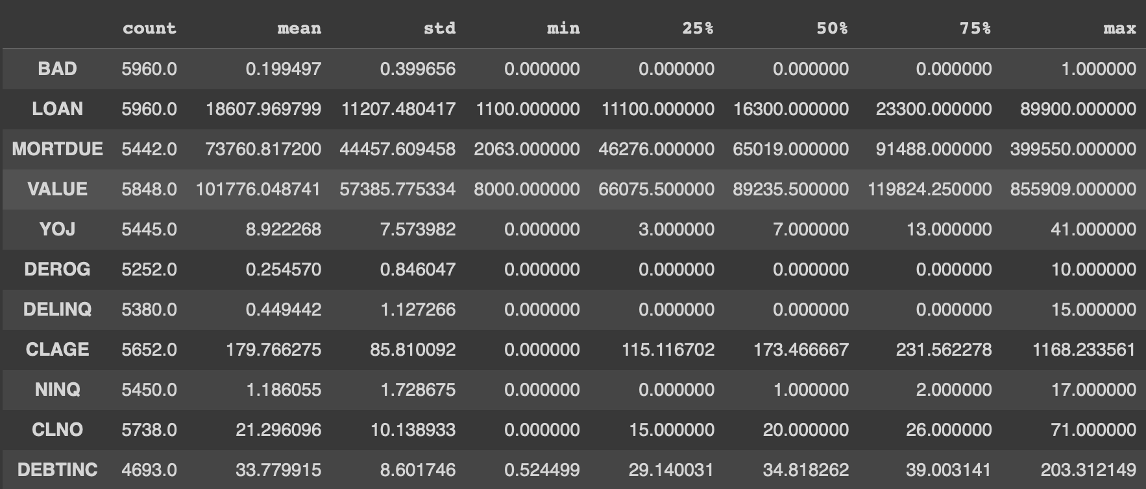
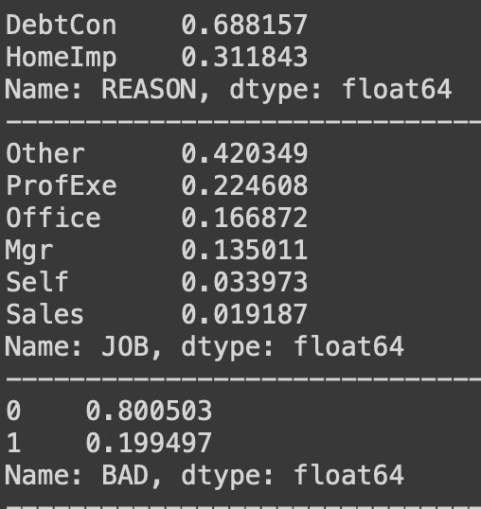
Overview of the Data
Numerical Variables
Categorical Variables

Slide 8
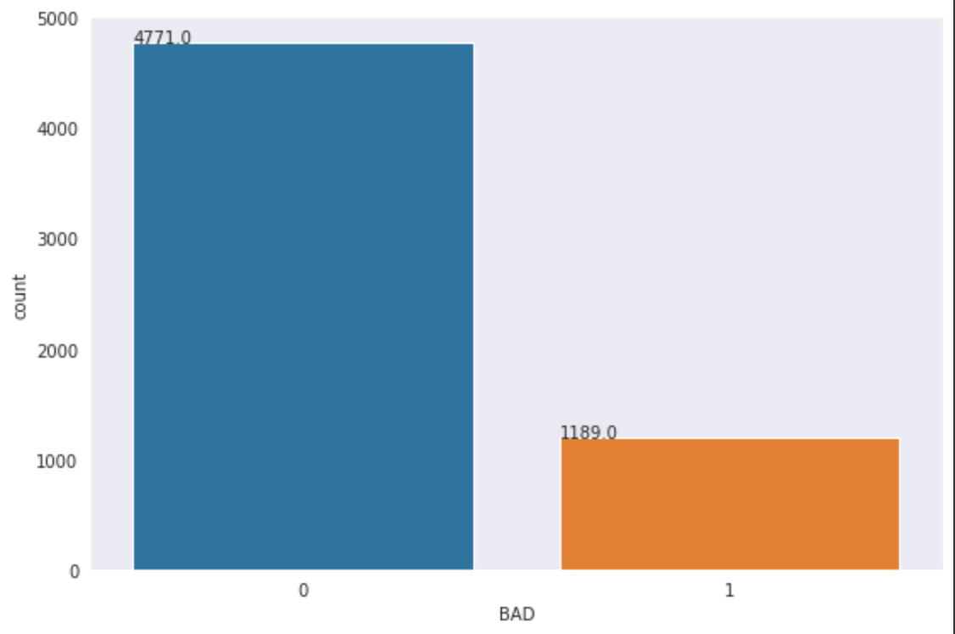
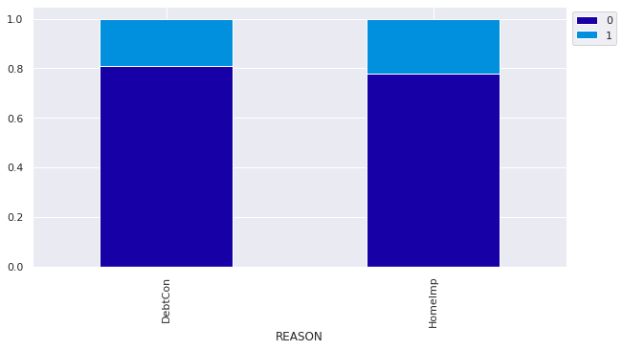
Overview of the Data
From 5,960 observations: 4,771 clients have paid back the loans and 1,189 clients have defaulted on loans
Out of the total loan of $110,903,500: $20,120,400 is the total of unpaid loans and $90,783,100 is the total of paid loans

Slide 9
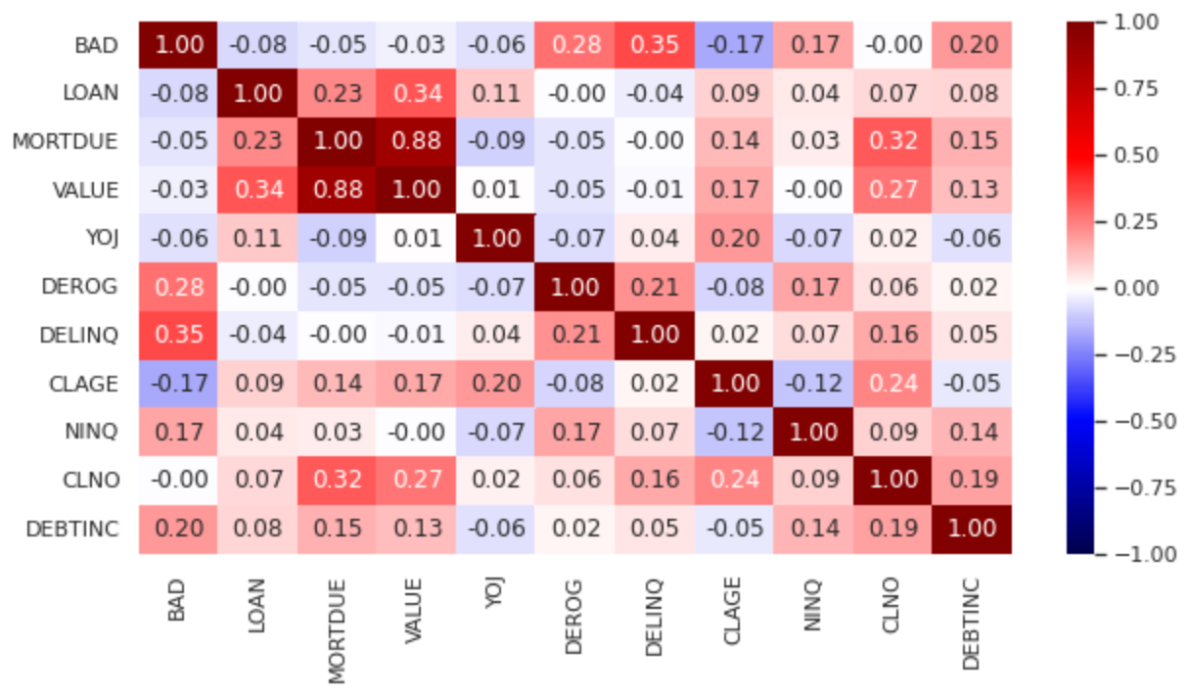
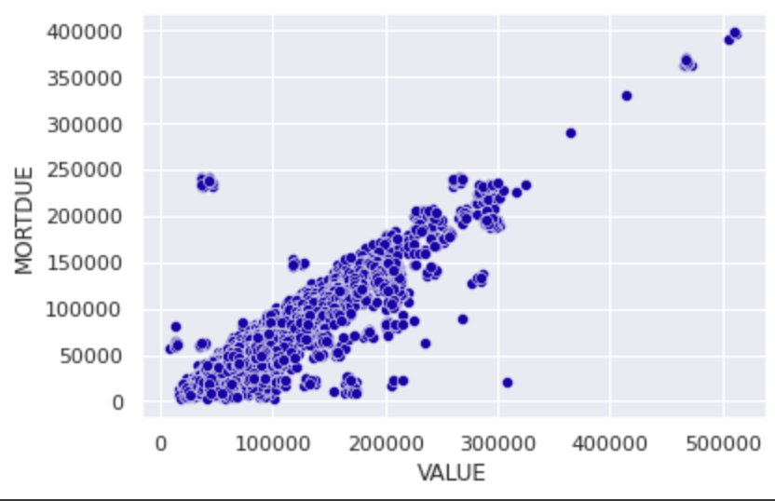
Overview of the Data: Correlation

Slide 10
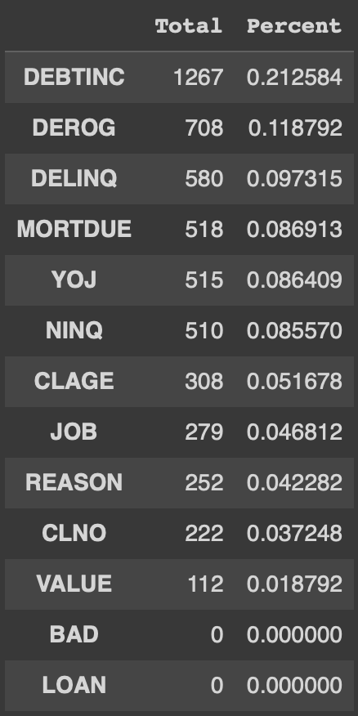
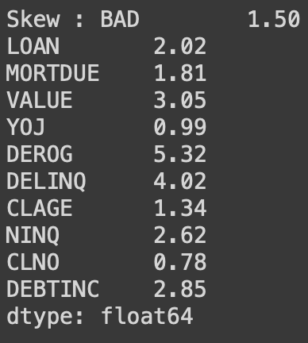
Overview of the Data: Dealing with NAs & Outliers
Percentages of missing values per column
Percentages of skewer per column
To deal with outliers:
1.Using IQR technique to identify the outliers
2. Using imputation technique to replace outliers with mean and median
Replacing numerical columns with mean
Replacing categorical columns with mode

Slide 11
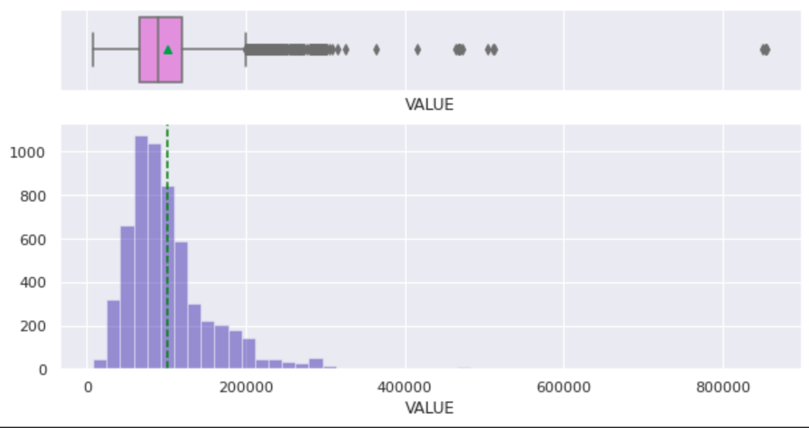
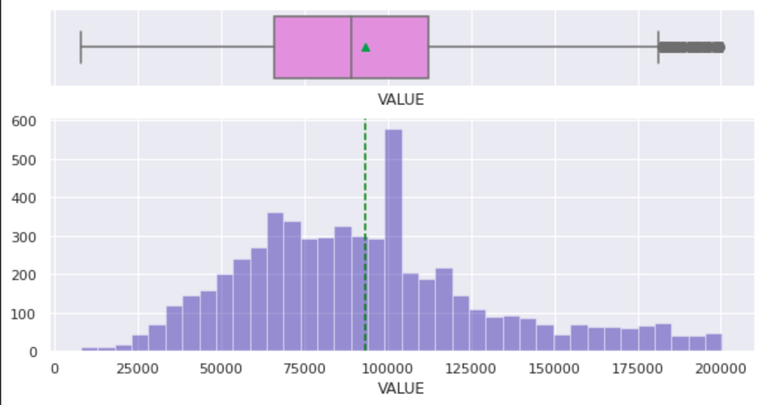
Before
After

Slide 12
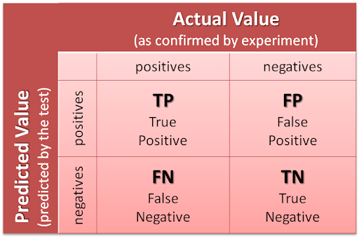
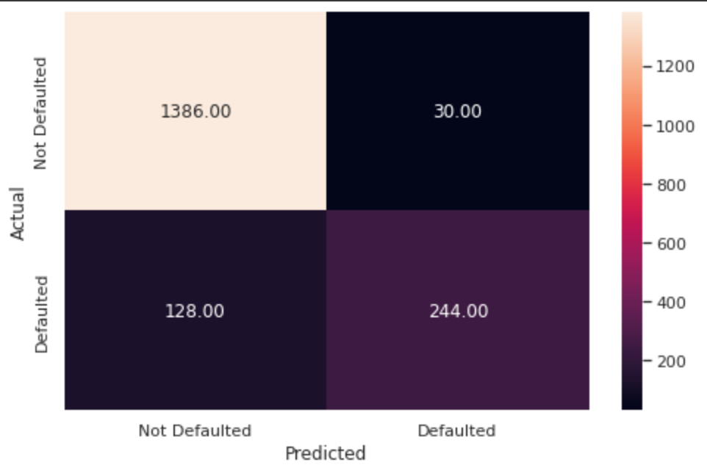
Analysis: Confusion Matrix
With FP: The retail banks will lost a chance to gain profits from these errors
With FN: The retail banks will lost profit and money from defaulted clients

Slide 13
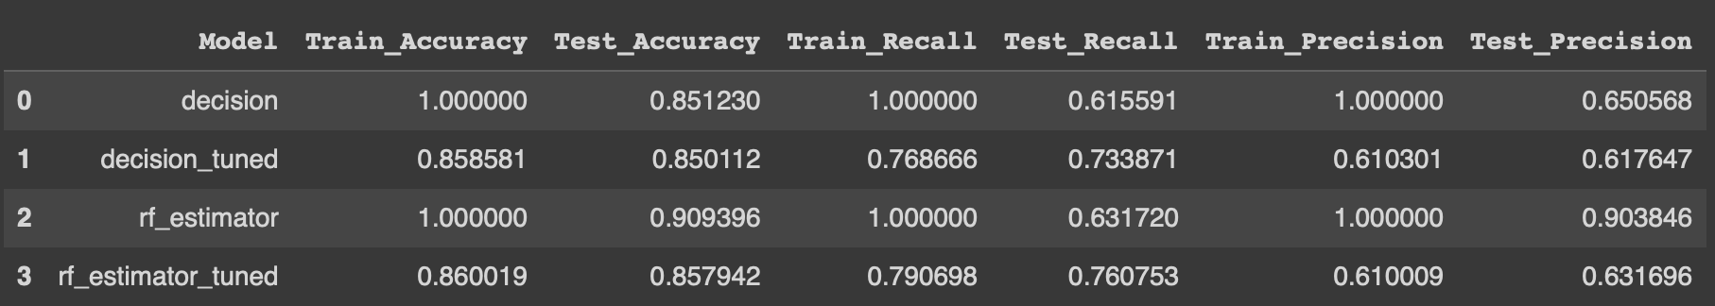
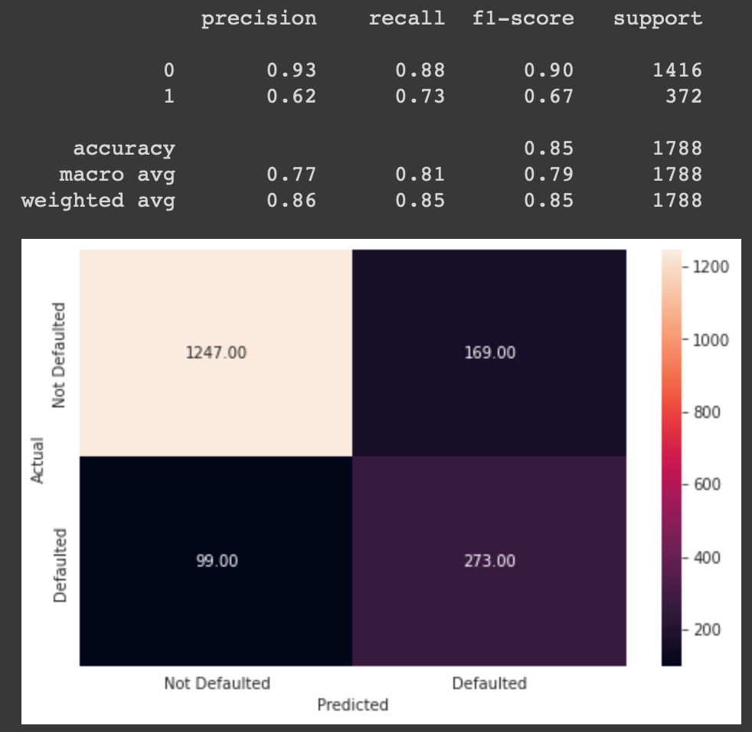
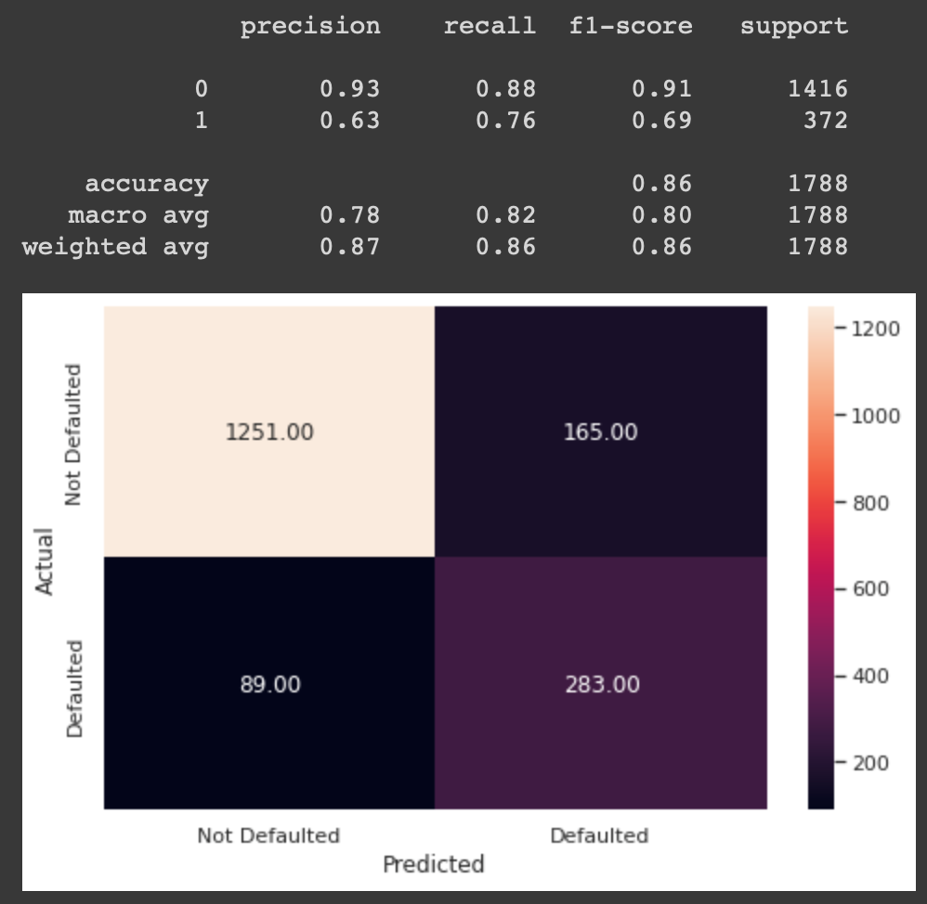
Analysis: Confusion Matrix
model 1
model 3

Slide 14
Analysis: Performance Score
Model 3’s performance is slidely better than Model 1’s performance; therefore, we will use Model 3’s to draw a business suggestions. Before we get to the business recommendation, let’s take a look at the performance score:
1.Accuracy Score: Model 3 has a similar performance score on accuracy on both train and test dataset. This is good because we can be sure that the model is not overfitted
2.Recall Score: To avoid the False Negative (due to high costs associated with False Negative), we will focus on the model with better recall score. It is obvious that Model 3 has the most higher score among other models (Model 0 and 2 = overfitted).
3.Precision Score: To maximize the profits, the precision score would be ideal here. However, the more potential profits we can get the more risks will be involved.

Slide 15
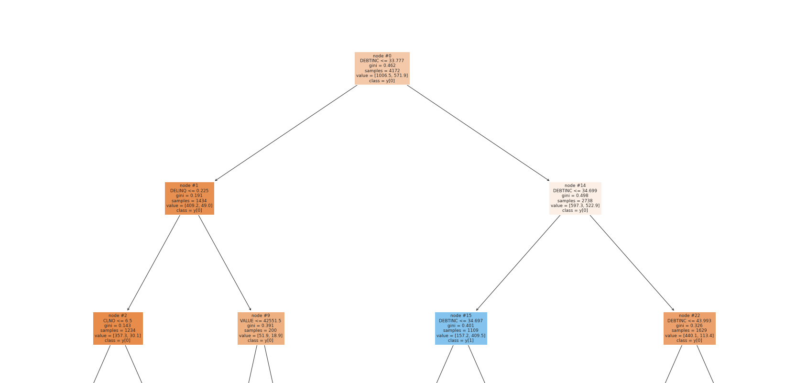
Analysis: Decision Tree
Clients with debt-to-income ratios <= 33.777
Non-Default
Clients with number of delinquent credit lines <= 0.225
Default

Slide 16
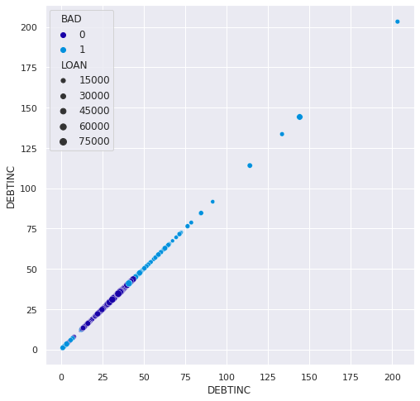
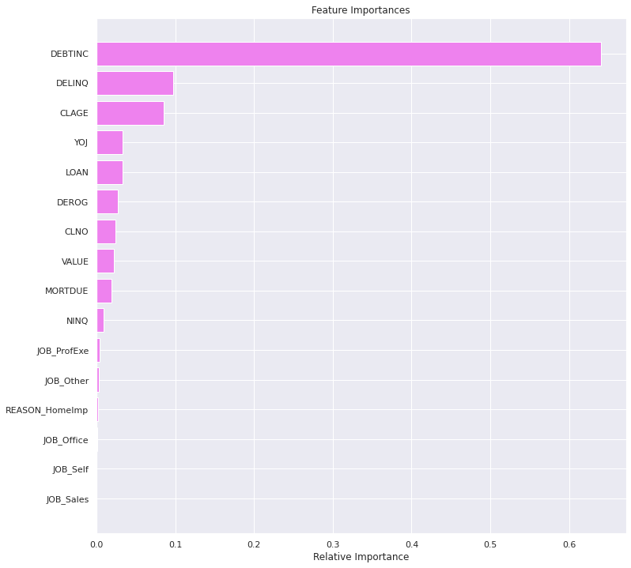
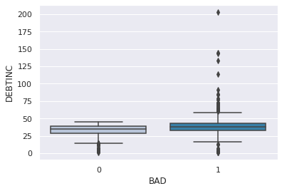
Analysis: Random Forest [Importance Features]

Slide 17
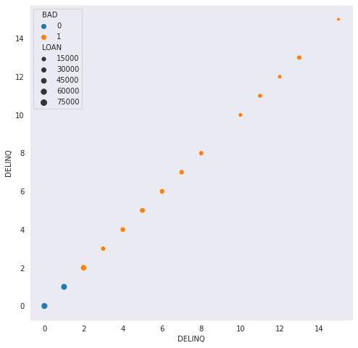
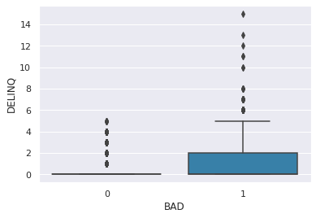
Analysis: Importance Features
Number of delinquent credit lines

Slide 18
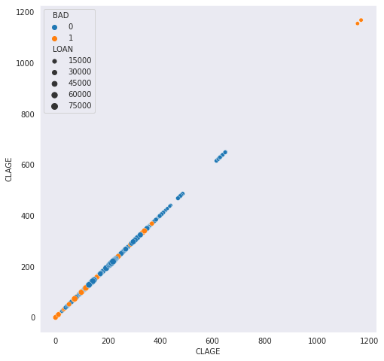
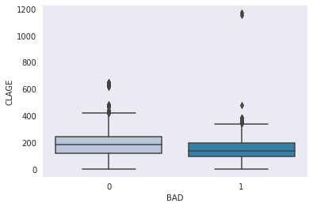
Analysis: Importance Features
Age of the oldest credit line in month

Slide 19
Business Recommendation and Limitations
Goal: Minimize losses
During the loan approval process, the retail bank should prioritize the clients with debt-to-income ratio between 20 - 37. This is the range that clients are more likely to pay back the loan.
During the loan approval process, the retail bank should prioritize the clients with number of delinquent credit lines less than 2. The data suggests that the clients with the number of delinquent credit lines more than 2 are more likely to default on loans.
During the loan approval process, the retail bank should prioritize the clients with the age of the oldest credit line in months more than 200.
Goal: Maximize profits
In order to gain profits, sometimes risks must be taken. For this reason, when approving loans for the clients who cannot meet the standard requirements above, the retail banks should increase interest rates for these clients.

Slide 20
Business Recommendation and Limitations
Goal: Maximize Profit (cont.)
For the clients who cannot meet the standard requirements, the retail banks should require guarantor in order to approve the loans.
Limitations and what can be done to improve the analysis
Increasing the number of observation to improve model’s accuracy and also decrease the outliers
Increasing more categories for jobs - so we can get more data about the clients’ jobs
According to the data analysis, the amount of loans approved is interesting as well. As it turns out, people with the small amount of loans are more likely to default on loans (based on statistical visualization). Therefore, the retail banks could conduct some in-depth researches to find out about this in the future.

Slide 21
Thank You !

Slide 22
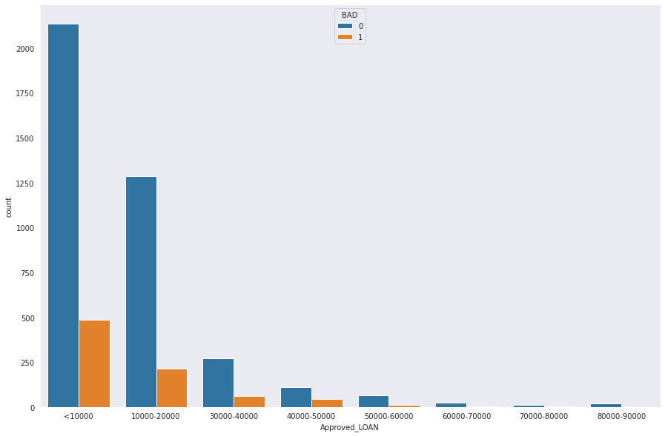
Appendix: Amount of Loans

Slide 23
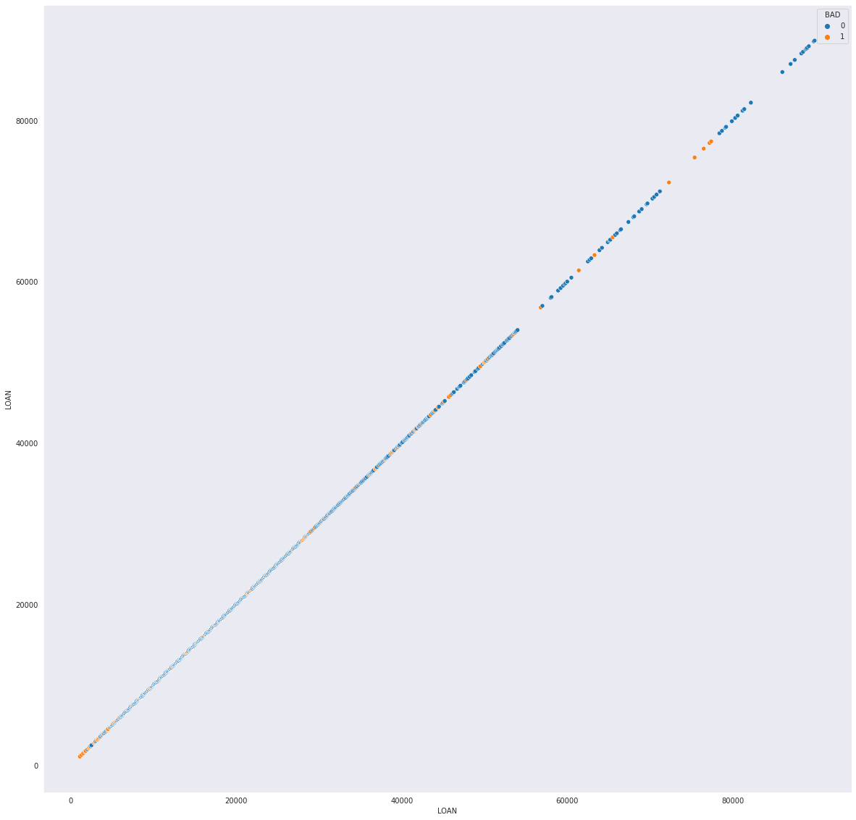
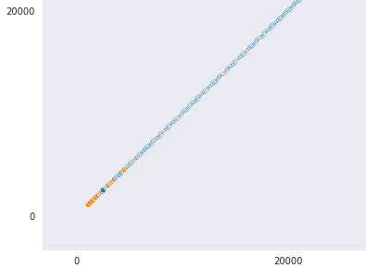
Appendix: Amount of Loans (Cont.)

